Slide 1

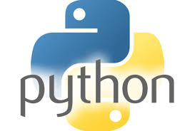
Marwadi University Faculty of Computer Applications MCA Sem- II
Basics of Python
(05MC0202)
Unit – 3
Object Oriented
Programming

Slide 2
OOP in Python
Python is an object-oriented programming language. Its means we can solve a problem in Python by creating objects in our programs
OOPs terms such as class, objects, methods etc. along with the Object oriented programming features such as inheritance, polymorphism, abstraction, encapsulation.

Slide 3
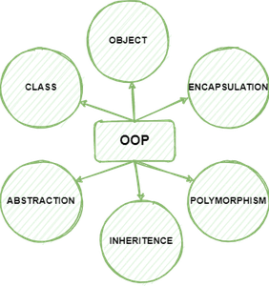
OOP in Python

Slide 4
Class & Object
A class is a blueprint for the objects. For example, Ram, Shyam, Steve, Rick are all objects so we can define a template (blueprint) class Human for these objects. The class can define the common attributes and behaviours of all the objects.
An object is an entity that has attributes and behaviour. For example, Ram is an object who has attributes such as height, weight, color etc. and has certain behaviours such as walking, talking, eating etc.

Slide 5
Class & Object
A class is defined using the keyword class.
class ClassName:
#statement_suite

Slide 6
Class & Object
Creating Objects of class
In this example, we have a class MyNewClass that has an attribute num and a function hello(). We are creating an object obj of the class and accessing the attribute value of object and calling the method hello() using the object

Slide 7
Class & Object
Example :
class MyNewClass:
"""This class demonstrates the creation of objects"""
# instance attribute
num = 100
# instance method
def hello(self):
print("Hello World!")
# creating object of MyNewClass
obj = MyNewClass()
# prints attribute value
print(obj.num)
# calling method hello()
obj.hello()
# prints docstring
print(MyNewClass.__doc__)
Output:
100
Hello World!
This class demonstrates the creation of objects

Slide 8
Class & Object
Another example for ref only :
class Student:
roll_num = 101
name = "Joseph"
def display(self):
print(self.roll_num,self.name)
obj = Student()
print(obj.roll_num)
print(obj.name)
obj.display()

Slide 9
Recursive Function in Python
A function is said to be a recursive if it calls itself. For example, lets say we have a function abc() and in the body of abc() there is a call to the abc().

Slide 10
Recursive Function in Python
Example :
# Example of recursion in Python to
# find the factorial of a given number
# Factorial of a number using recursion
def recur_factorial(n):
if n == 1:
return n
else:
return n*recur_factorial(n-1)
num = 5
# check if the number is negative
if num < 0:
print("Sorry, factorial does not exist for negative numbers")
elif num == 0:
print("The factorial of 0 is 1")
else:
print("The factorial of", num, "is", recur_factorial(num))
Output:
Factorial of 5 is: 120

Slide 11
Advantages of Recursion
Recursion makes our program:
1. Easier to write.
2. Readable – Code is easier to read and understand.
3. Reduce the lines of code – It takes less lines of code to solve a problem using recursion.

Slide 12
Constructors
A constructor is a special kind of method which is used for initializing the instance variables during object creation.
Constructor is used for initializing the instance members when we create the object of a class.
The __init__() Function
All classes have a function called __init__(), which is always executed when the class is being initiated.
Use the __init__() function to assign values to object properties, or other operations that are necessary to do when the object is being create.
The __init__() function is called automatically every time the class is being used to create a new object.

Slide 13
Constructors
For example:
class Employee:
def __init__(self, name, id):
self.id =id
self.name = name
def display(self):
print(self.id, self.name)
emp1 = Employee("John", 101)
emp2 = Employee("David", 102)
# accessing display() method to print employee 1 information
emp1.display()
# accessing display() method to print employee 2 information
emp2.display()
Output:
ID: 101
Name: John
ID: 102
Name: David

Slide 14
Types of Constructors
We have mainly two types of constructors in Python.
Default constructor – this is the one, which we have seen in the above example. This constructor doesn’t accept any arguments.
Parameterized constructor – constructor with parameters is known as parameterized constructor

Slide 15
Default Constructor
When we do not include the constructor in the class or forget to declare it, then that becomes the default constructor. It does not perform any task but initializes the objects. Consider the following example.

Slide 16
Default Constructor
Example
class Student:
roll_num = 101
name = "Joseph"
def display(self):
print(self.roll_num,self.name)
obj = Student()
obj.display()
Output:
101 Joseph

Slide 17
Non Parameterized Constructor
The non-parameterized constructor uses when we do not want to manipulate the value or the constructor that has only self as an argument. Consider the following example.
Example
class Student:
# Constructor - non parameterized
def __init__(self):
print("This is non parametrized constructor")
def show(self,name):
print("Hello",name)
obj = Student()
obj.show("John")

Slide 18
Parameterized Constructor
The parameterized constructor has multiple parameters along with the self. Consider the following example.
Example
class Student:
# Constructor - parameterized
def __init__(self, name):
print("This is parametrized constructor")
self.name = name
def show(self):
print("Hello",self.name)
obj = Student("John")
obj.show()
Output:
This is parametrized constructor
Hello John

Slide 19
Examples
class Person:
def __init__(self, name, age):
self.name = name
self.age = age
p1 = Person("John", 36)
print(p1.name)
print(p1.age)

Slide 20
Examples
#DEFAULT CONSTRUCTOR
class Employee:
id = 10
name = "John"
def display (self):
print("ID: %d \nName: %s"%(self.id,self.name))
# Creating a emp instance of Employee class
emp = Employee()
emp.display()

Slide 21
Examples
#PARAMETRIZED CONSTRCTOR
class Employee:
def __init__(self, name, id):
self.id = id
self.name = name
def display(self):
print("ID: %d \nName: %s" % (self.id, self.name))
emp1 = Employee("John", 101)
emp2 = Employee("David", 102)
# accessing display() method to print employee 1 information
emp1.display()
# accessing display() method to print employee 2 information
emp2.display()

Slide 22
Self in Python
Self represents the instance of the class. By using the “self” we can access the attributes and methods of the class in Python.
It binds the attributes with the given arguments.
The reason you need to use self. is because Python does not use the @ syntax to refer to instance attributes
When working with classes in Python, the term “self” refers to the instance of the class that is currently being used.

Slide 23
Self in Python
It is customary to use “self” as the first parameter in instance methods of a class.
Whenever you call a method of an object created from a class, the object is automatically passed as the first argument using the “self” parameter.
This enables you to modify the object’s properties and execute tasks unique to that particular instance.

Slide 24
Self in Python
class mynumber:
def __init__(self, value):
self.value = value
def print_value(self):
print(self.value)
obj1 = mynumber(17)
obj1.print_value()
Output:
17

Slide 25
Instance variable in python
If the value of a variable varies from object to object, then such variables are called instance variables. For every object, a separate copy of the instance variable will be created.
Instance variables are not shared by objects. Every object has its own copy of the instance attribute. This means that for each object of a class, the instance variable value is different.
When we create classes in Python, instance methods are used regularly. we need to create an object to execute the block of code or action defined in the instance method.

Slide 26
Instance variable in python
Instance variables are used within the instance method. We use the instance method to perform a set of actions on the data/value provided by the instance variable.
We can access the instance variable using the object and dot (.) operator.
In Python, to work with an instance variable and method, we use the self keyword. We use the self keyword as the first parameter to a method. The self refers to the current object.

Slide 27
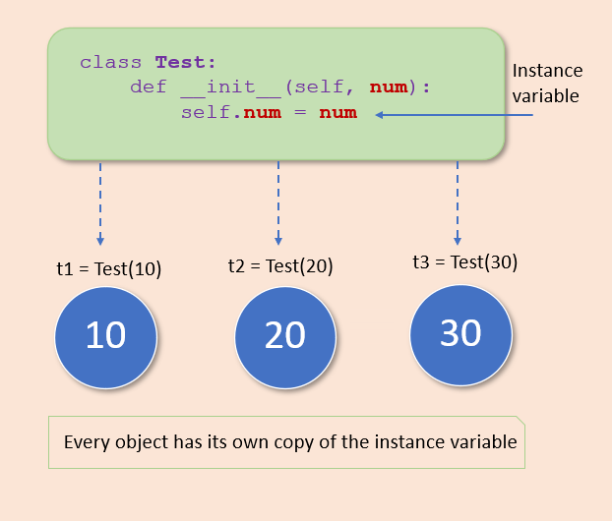
Instance variable in python

Slide 28
Instance method in python
Instance methods: Used to access or modify the object state. If we use instance variables inside a method, such methods are called instance methods. It must have a self parameter to refer to the current object.
Any method we create in a class will automatically be created as an instance method unless we explicitly tell Python that it is a class or static method.

Slide 29
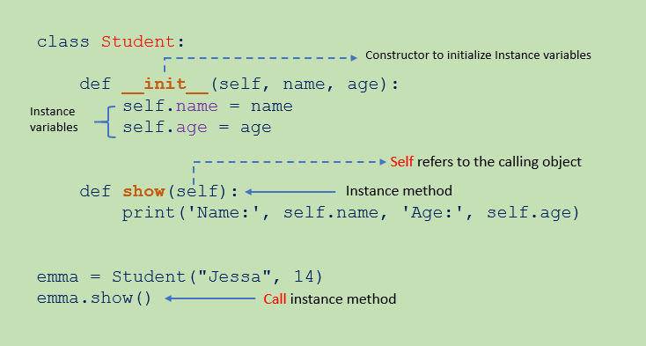
Instance method in python

Slide 30
Important Note :
Inside any instance method, we can use self to access any data or method that reside in our class. We are unable to access it without a self parameter.
An instance method can freely access attributes and even modify the value of attributes of an object by using the self parameter.
By Using self.__class__ attribute we can access the class attributes and change the class state. Therefore instance method gives us control of changing the object as well as the class state.

Slide 31
Class Variable in python
If the value of a variable is not varied from object to object, such types of variables are called class variables or static variables.
Class variables are shared by all instances of a class. Unlike instance variable, the value of a class variable is not varied from object to object.
A class variable is declared inside of class, but outside of any instance method or __init__() method.

Slide 32
Class Variable in python
class Student:
# Class variable
school_name = 'ABC School '
def __init__(self, name, roll_no):
self.name = name
self.roll_no = roll_no
# create first object
s1 = Student('Emma', 10)
print(s1.name, s1.roll_no, Student.school_name)
# access class variable
# create second object
s2 = Student('Jessa', 20)
# access class variable
print(s2.name, s2.roll_no, Student.school_name)

Slide 33
Class Variable in python
Example : Access Class Variable in the constructor
class Student:
# Class variable
school_name = 'ABC School ‘
# constructor
def __init__(self, name):
self.name = name
# access class variable inside constructor using self
print(self.school_name)
# access using class name
print(Student.school_name)
# create Object
s1 = Student('Emma')

Slide 34
Class Variable in python
Example : Access Class Variable in Instance method and outside class
class Student:
# Class variable
school_name = 'ABC School ‘
# constructor
def __init__(self, name, roll_no):
self.name = name
self.roll_no = roll_no
# Instance method
def show(self):
print('Inside instance method')
# access using self
print(self.name, self.roll_no, self.school_name)
# access using class name
print(Student.school_name)

Slide 35
Class Variable in python
# create Object
s1 = Student('Emma', 10)
s1.show()
print('Outside class')
# access class variable outside class
# access using object reference
print(s1.school_name)
# access using class name
print(Student.school_name)
O/p.
Inside instance method
Emma 10 ABC School
ABC School
Outside class
ABC School
ABC School

Slide 36
Class Method in python
Used to access or modify the class state. In method implementation, if we use only class variables, then such type of methods we should declare as a class method. The class method has a cls parameter which refers to the class.
A class method is bound to the class and not the object of the class. It can access only class variables.
Class method works with the class since its parameter is always the class itself.

Slide 37
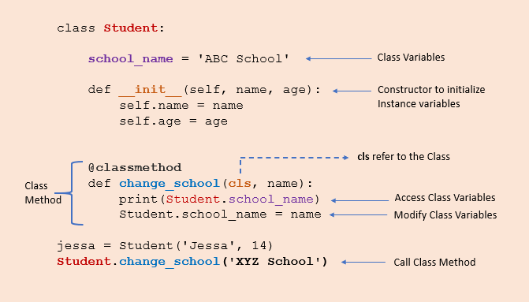
Class Method in python

Slide 38
Class Method in python
The class method can be called both by the class and its object.
Class.classmethod()
Or even
Class().classmethod()
But no matter what, the class method is always attached to a class with the first argument as the class itself cls.
def classMethod(cls, args...)

Slide 39
Class Method in python
Example : Create class method using classmethod()
class Person:
age = 25
def printAge(cls):
print('The age is:', cls.age)
# create printAge class method
Person.printAge = classmethod(Person.printAge)
Person.printAge()
O/p.
The Age is : 25

Slide 40
Important Points
Here, we have a class Person, with a member variable age assigned to 25.
We also have a function printAge that takes a single parameter cls and not self we usually take.
cls accepts the class Person as a parameter rather than Person's object/instance.
Now, we pass the method Person.printAge as an argument to the function classmethod. This converts the method to a class method so that it accepts the first parameter as a class (i.e. Person).
In the final line, we call printAge without creating a Person object like we do for static methods. This prints the class variable age.

Slide 41
Important Points
Example : ( simple class method)
class mca:
course = ‘Python'
def purchase(obj):
print("Purchase course : ", obj.course)
mca.purchase = classmethod(mca.purchase)
mca.purchase()
O/p.
Output:
Purchase course : DSA

Slide 42
Important Points
Create class method using classmethod() :
class Student:
# create a variable
name = “Pythonfor python"
# create a function
def print_name(obj):
print("The name is : ", obj.name)
# create print_name classmethod
# before creating this line print_name()
# It can be called only with object not with class
Student.print_name = classmethod(Student.print_name)
# now this method can be called as classmethod
# print_name() method is called a class method
Student.print_name()

Slide 43
Static methods in python
A static method is a general utility method that performs a task in isolation. Static methods in Python are similar to those found in Java or C++.
A static method is bound to the class and not the object of the class. Therefore, we can call it using the class name.
A static method doesn’t have access to the class and instance variables because it does not receive an implicit first argument like self and cls. Therefore it cannot modify the state of the object or class.
The class method can be called using ClassName.method_name() as well as by using an object of the class.

Slide 44
Static methods in python
Example :
class Employee:
@staticmethod
def sample(x):
print('Inside static method', x)
# call static method
Employee.sample(10)
# can be called using object
emp = Employee() emp.sample(10)

Slide 45
Static methods in python
Example :
class Calculator:
def addNumbers(x, y):
return x + y
# create addNumbers static method
Calculator.addNumbers = staticmethod(Calculator.addNumbers)
print('Product:', Calculator.addNumbers(15, 110))
Note that we called the addNumbers we created without an object. When we run this program, here is the output we will get:
Product: 125

Slide 46
Private variables and methods in python
Private members in programming languages (such as C++ and Java) are the members that are only available to their own class. Neither the subclasses nor the classes in the same package have access to them.
In Python, there is no such strict enforcement of privacy. It does not have access specifiers like other languages to make variables or methods private to the class.
However, we can use the name mangling feature of Python to make a variable or method appear as restricted.

Slide 47
Private variables and methods in python
We have to prefix the __ (double underscore) in the name of the variable to represent it as a private variable.
class BankAccount:
def __init__(self, balance):
self.__balance = balance
#private variable
def displayBalance(self):
print("Balance: ", self.__balance)
myaccount = BankAccount('85,33,999') myaccount.displayBalance()
print(myaccount.__balance)
#outputs 'Balance: 85,33,999'
#AttributeError: object has no attribute '__balance‘
Accessing the variable __balance through object throws an error because Python has scrambled its name to _BankAccount__balance (class name with leading underscore followed by the name of the variable).

Slide 48
Private variables and methods in python
Python does it so to ensure that subclasses don’t accidentally override the private attributes of the parent class.
If we replace the name with _BankAccount__balance in the print statement, then it works fine.
print(myaccount._BankAccount__balance)
#outputs '85,33,999‘
The same concept is applicable to methods also. Prefixing the __ in the name of the member methods (__displayBalance), mangles its name (_BankAccount__displayBalance).

Slide 49
Private variables and methods in python
class BankAccount:
def __init__(self, balance):
self.__balance = balance #private variable
#private method
def __displayBalance(self):
print("Balance: ", self.__balance)
myaccount = BankAccount('85,33,999') myaccount.__displayBalance()
#AttributeError: object has no attribute '__displayBalance'

Slide 50
Important Points
At the end, we can conclude that Python has no strict mechanism to make variables and methods private.
Although, we can prefix __ (double underscore) in the name as to enforce the name mangling, the attributes can still be accessed by the other classes.

Slide 51
Inner Class in python
A class defined inside another class is known as an inner class in Python.
Sometimes inner class is also called nested class.
If the inner class is instantiated, the object of inner class can also be used by the parent class.
Object of inner class becomes one of the attributes of the outer class.
Inner class automatically inherits the attributes of the outer class without formally establishing inheritance.
An inner class lets you group classes.
One of the advantages of nesting classes is that it becomes easy to understand which classes are related.
The inner class has a local scope. It acts as one of the attributes of the outer class.

Slide 52
Inner Class in python
Syntax :
class outer:
def __init__(self):
pass
class inner:
def __init__(self):
pass

Slide 53
Inner Class in python
Example
class student:
def __init__(self):
self.name = "Ashish"
self.subs = self.subjects()
return
def show(self):
print ("Name:", self.name)
self.subs.display()
class subjects:
def __init__(self):
self.sub1 = "Phy"
self.sub2 = "Che"
return
def display(self):
print ("Subjects:",self.sub1, self.sub2)
s1 = student()
s1.show()
Output :
Name: Ashish
Subjects: Phy Che

Slide 54
Inheritance
Inheritance is an important aspect of the object-oriented paradigm.
Inheritance provides code reusability to the program because we can use an existing class to create a new class instead of creating it from scratch.
In inheritance, the child class acquires the properties and can access all the data members and functions defined in the parent class.
A child class can also provide its specific implementation to the functions of the parent class.
In python, a derived class can inherit base class by just mentioning the base in the bracket after the derived class name.
Consider the following syntax to inherit a base class into the derived class.

Slide 55
Inheritance

Slide 56
Inheritance
Syntax :
class derived-class(base class):
<class-suite>
A class can inherit multiple classes by mentioning all of them inside the bracket. Consider the following syntax.
Syntax :
class derive-class(<base class 1>, <base class 2>, ..... <base class n>):
<class - suite>

Slide 57
Inheritance
Example :
class Animal:
def speak(self):
print("Animal Speaking")
#child class Dog inherits the base class Animal
class Dog(Animal):
def bark(self):
print("dog barking")
d = Dog()
d.bark()
d.speak()
Output:
dog barking
Animal Speaking

Slide 58
Multilevel Inheritance
Multi-Level inheritance is possible in python like other object-oriented languages.
Multi-level inheritance is archived when a derived class inherits another derived class.
There is no limit on the number of levels up to which, the multi-level inheritance is archived in python.

Slide 59
Multilevel Inheritance
Syntax :
class class1:
<class-suite>
class class2(class1):
<class suite>
class class3(class2):
<class suite>

Slide 60
Multilevel Inheritance
Example :
class Animal:
def speak(self):
print("Animal Speaking")
#The child class Dog inherits the base class Animal
class Dog(Animal):
def bark(self):
print("dog barking")
#The child class Dogchild inherits another child class Dog
class DogChild(Dog):
def eat(self):
print("Eating bread...")
d = DogChild()
d.bark()
d.speak()
d.eat()
Output :
dog barking
Animal Speaking
Eating bread

Slide 61
Multilevel Inheritance
Another Example:
class A: # parent
def funA(self):
print("this is from class A")
class B(A): # child
def funB(self):
print("this is from class B")
class C(B):
def funC(self):
print("this is from class C")
objc=C()
objc.funA()
objc.funB()
objc.funC()
Output :
this is from class A
this is from class B
this is from class C

Slide 62
Multiple Inheritance
Python provides us the flexibility to inherit multiple base classes in the child class.

Slide 63
Multilevel Inheritance
Syntax :
class Base1:
<class-suite>
class Base2:
<class-suite>
.
.
.
class BaseN:
<class-suite>
class Derived(Base1, Base2, ...... BaseN):
<class-suite>

Slide 64
Multilevel Inheritance
Example :
class Calculation1:
def Summation(self,a,b):
return a+b;
class Calculation2:
def Multiplication(self,a,b):
return a*b;
class Derived(Calculation1,Calculation2):
def Divide(self,a,b):
return a/b;
d = Derived()
print(d.Summation(10,20))
print(d.Multiplication(10,20))
print(d.Divide(10,20))
Output :
30
200
0.5

Slide 65
Method Resolution Order (MRO)
The term “Method Resolution Order" is related to multiple inheritance in Python.
In Python, inheritance may be spread over more than one levels.
Let us say A is the parent of B, and B the parent for C.
The class C can override the inherited method or its object may invoke it as defined in its parent.
So, how does Python find the appropriate method to call.
Each Python has a mro() method that returns the hierarchical order that Python uses to resolve the method to be called.
The resolution order is from bottom of inheritance order to top.

Slide 66
Method Resolution Order (MRO)
class A:
def foo(self):
print("A")
class B(A):
def foo(self):
print("B")
class C(B):
def foo(self):
print("C")
c = C()
c.foo()
O/p.
C

Slide 67
Method Resolution Order (MRO)
In this example, the MRO of the C class is [C, B, A]. This means that when Python is looking for the foo() method, it will first search the C class. If the method is not found there, it will then search the B class, and then the A class.
The MRO is an important concept in Python inheritance. It allows Python to determine the order in which methods are searched for in a class hierarchy. This is especially important in multiple inheritance, where a method may be defined in multiple parent classes.

Slide 68
Method Overloading
Method overloading is an important feature of object-oriented programming. Java, C++, C# languages support method overloading, but in Python it is not possible to perform method overloading.
When you have a class with method of one name defined more than one but with different argument types and/or return type, it is a case of method overloading. Python doesn't support this mechanism as the following code shows −

Slide 69
Method Overloading
class example:
def add(self, a, b):
x = a+b
return x
def add(self, a, b, c):
x = a+b+c
return x
obj = example()
print (obj.add(10,20,30))
print (obj.add(10,20))

Slide 70
Method Overloading
The first call to add() method with three arguments is successful. However, calling add() method with two arguments as defined in the class fails.
60
Traceback (most recent call last):
File "C:\Users\user\example.py", line 12, in <module>
print (obj.add(10,20))
^^^^^^^^^^^^^^
TypeError: example.add() missing 1 required positional argument: 'c'

Slide 71
Method Overloading
The output tells you that Python considers only the latest definition of add() method, discarding the earlier definitions.
To simulate method overloading, we can use a workaround by defining default value to method arguments as None, so that it can be used with one, two or three arguments.

Slide 72
Method Overloading
class example:
def add(self, a = None, b = None, c = None):
x=0
if a !=None and b != None and c != None:
x = a+b+c
elif a !=None and b != None and c == None:
x = a+b
return x
obj = example()
print (obj.add(10,20,30))
print (obj.add(10,20))

Slide 73
Method Overloading
It will produce the following output −
60
30
With this workaround, we are able to incorporate method overloading in Python class.
Python's standard library doesn't have any other provision for implementing method overloading. However, we can use dispatch function from a third party module named MultipleDispatch for this purpose.
First, you need to install the Multipledispatch module.
pip install multipledispatch - This command needs to be given at command prompt

Slide 74
Method Overloading
This module has a @dispatch decorator. It takes the number of arguments to be passed to the method to be overloaded. Define multiple copies of add() method with @dispatch decorator as below −

Slide 75
Method Overloading
from multipledispatch import dispatch
class example:
@dispatch(int, int)
def add(self, a, b):
x = a+b
return x
@dispatch(int, int, int)
def add(self, a, b, c):
x = a+b+c
return x
obj = example()
print (obj.add(10,20,30))
print (obj.add(10,20))
O/p.
60
30

Slide 76
Operator Overloading
The operator overloading in Python means provide extended meaning beyond their predefined operational meaning.
Such as, we use the "+" operator for adding two integers as well as joining two strings or merging two lists.
We can achieve this as the "+" operator is overloaded by the "int" class and "str" class.
The user can notice that the same inbuilt operator or function is showing different behaviour for objects of different classes.
This process is known as operator overloading.

Slide 77
Operator Overloading
print (14 + 32)
# Now, we will concatenate the two strings
print (“MCA" + “2B")
# We will check the product of two numbers
print (23 * 14)
# Here, we will try to repeat the String
print ("X Y Z " * 3)
O/p.
46
MCA2B
322
X Y Z X Y Z X Y Z

Slide 78
How to perform Operator Overloading
Suppose the user has two objects which are the physical representation of a user-defined data type class.
The user has to add two objects using the "+" operator, and it gives an error.
This is because the compiler does not know how to add two objects.
So, the user has to define the function for using the operator, and that process is known as "operator overloading".
The user can overload all the existing operators by they cannot create any new operator.

Slide 79
How to perform Operator Overloading
Python provides some special functions, or we can say magic functions for performing operator overloading, which is automatically invoked when it is associated with that operator.
Such as, when the user uses the "+" operator, the magic function __add__ will automatically invoke in the command where the "+" operator will be defined.

Slide 80
How to perform Binary + Operator Overloading
When the user uses the operator on the user-defined data types of class, then a magic function that is associated with the operator will be invoked automatically.
The process of changing the behaviour of the operator is as simple as the behaviour of the function or method defined.
The user define methods or functions in the class and the operator works according to that behaviour defined in the functions. When the user uses the "+" operator, it will change the code of a magic function, and the user has an extra meaning of the "+" operator.

Slide 81
How to perform Binary + Operator Overloading
class example:
def __init__(self, X):
self.X = X
# adding two objects
def __add__(self, U):
return self.X + U.X
object_1 = example( int( input( print ("Please enter the value: "))))
object_2 = example( int( input( print ("Please enter the value: "))))
print (": ", object_1 + object_2)
object_3 = example(str( input( print ("Please enter the value: "))))
object_4 = example(str( input( print ("Please enter the value: "))))
print (": ", object_3 + object_4)
O/p.
Please enter the value: 23
Please enter the value: 21
: 44
Please enter the value: MCA
Please enter the value: 2B
: MCA2B

Slide 82
How to perform Binary + Operator Overloading
class complex_1:
def __init__(self, X, Y):
self.X = X
self.Y = Y
# Now, we will add the two objects
def __add__(self, U):
return self.X + U.X, self.Y + U.Y
Object_1 = complex_1(23, 12)
Object_2 = complex_1(21, 22)
Object_3 = Object_1 + Object_2
print (Object_3)
O/p.
(44, 34)

Slide 83
How to perform Comparison Operator Overloading
class example_1:
def __init__(self, X):
self.X = X
def __gt__(self, U):
if(self.X > U.X):
return True
else:
return False
object_1 = example_1(int( input( print ("Please enter the value: "))))
object_2 = example_1(int (input( print("Please enter the value: "))))
if(object_1 > object_2):
print ("The object_1 is greater than object_2")
else:
print ("The object_2 is greater than object_1")
O/p.
Please enter the value: 23
Please enter the value: 12
The object_1 is greater than object_2

Slide 84
Operators and its magic functions
Operator | Magic Function
+ | __add__(self, other)
- | __sub__(self, other)
* | __mul__(self, other)
/ | __truediv__(self, other)
// | __floordiv__(self, other)
% | __mod__(self, other)
** | __pow__(self, other)
>> | __rshift__(self, other)
<< | __lshift__(self, other)
& | __and__(self, other)
| | __or__(self, other)
^ | __xor__(self, other)

Slide 85
Operators and its magic functions
Operator | Magic Function
< | __LT__(SELF, OTHER)
> | __GT__(SELF, OTHER)
<= | __LE__(SELF, OTHER)
>= | __GE__(SELF, OTHER)
== | __EQ__(SELF, OTHER)
!= | __NE__(SELF, OTHER)

Slide 86
Operators and its magic functions
Operator | Magic Function
-= | __ISUB__(SELF, OTHER)
+= | __IADD__(SELF, OTHER)
*= | __IMUL__(SELF, OTHER)
/= | __IDIV__(SELF, OTHER)
//= | __IFLOORDIV__(SELF, OTHER)
%= | __IMOD__(SELF, OTHER)
**= | __IPOW__(SELF, OTHER)
>>= | __IRSHIFT__(SELF, OTHER)
<<= | __ILSHIFT__(SELF, OTHER)
&= | __IAND__(SELF, OTHER)
|= | __IOR__(SELF, OTHER)
^= | __IXOR__(SELF, OTHER)

Slide 87
Operators and its magic functions
Operator | Magic Function
- | __NEG__(SELF, OTHER)
+ | __POS__(SELF, OTHER)
~ | __INVERT__(SELF, OTHER)

Slide 88
Method Overriding
Any object-oriented programming language can allow a subclass or child class to offer a customized implementation of a method already supplied by one of its superclasses or parent classes.
This capability is known as method overriding.
The term "override" refers to a method in a subclass that replaces a method in a superclass when both methods share the same name, parameters, signature, and return type (or sub-type).

Slide 89
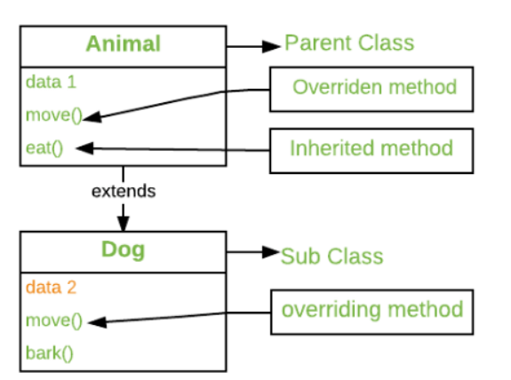
Method Overriding

Slide 90
Method Overriding
The object that calls a method will determine which version of the method is executed.
When a method is called from an object of a parent class, the method's parent class version is executed; however, when a method is called from an object of a subclass, the child class version is executed.
In other words, the version of an overridden method depends on the object being referenced, not the type of the reference variable.

Slide 91
Method Overriding
# program to determine the method overriding
# Defining a parent class
class Parent():
# producer
def __init__(self):
self.value = "Inside Parent"
# showing a parents method
def show(self):
print(self.value)
# Defining a child class
class Child(Parent):
# Constructor
def __init__(self):
self.value = "Inside Child"
# showing the child's method
def show(self):
print(self.value)
# Chauffeur's code
obj1 = Parent()
obj2 = Child()
obj1.show()
obj2.show()

Slide 92
Method Overriding
# program to determine
# calling the Parent's class method
# In the overridden method
class Parent ():
def show(self):
print ("Inside Parent")
class Child (Parent):
def show(self):
# child's class method is called
Parent.show(self)
Print ("Inside Child")
obj = Child ()
obj. show ()
O/p.
Inside Parent
Inside Child

Slide 93
Use of Super
# Program to determine the Super () function used
# In multiple inheritances
class JTP1:
def __init__(self):
print ('HEY !!!!!! jtpI am initialized (Class JSP1)')
def sub_JTP (self, b):
print ('Printing from class JTP1:', b)
# inheritance of JTP2 to JTP1 occurs
class JTP2(JTP1):
def __init__(self):
print ('HEY !!!!!! JTP I am initialized (Class JSP2)')
super().__init__()
def sub_JTP (self, b):
print ('Printing from class JTP2:', b)
super (). sub_JTP (b + 1)
# inheritance of both JTP2 and JTP1 is done by JTP3
class JTP3(JTP2):
def __init__(self):
print ('HEY !!!!!! JTP I am initialized (Class JSP3)')
super().__init__()
def sub_JTP (self, b):
print ('Printing from class JTP3:', b)
super ().sub_JTP(b + 1)
# function main
if __name__ == '__main__':
jtp = JTP3()
jtp.sub_JTP(10)
O/p.
HEY !!!!!! JTP I am initialized (Class JSP3)
HEY !!!!!! JTP I am initialized (Class JSP2)
HEY !!!!!! JTP I am initialized (Class JSP1)
Printing from class JTP3: 10
Printing from class JTP3: 11
Printing from class JTP3: 12

Slide 94
Interface
Generally, the interface is not part of Python, but we can implement it using the ABC module.
We will understand how to interface works and cautions of Python interface creation.
Interfaces play a crucial role in software engineering as they provide a way to define a set of methods or behaviors that a class must implement.
As an application grows in size and complexity, it becomes more difficult to manage updates and changes to the code base.

Slide 95
Interface
One common problem that arises is the presence of classes that have similar functionality but are unrelated in terms of their inheritance hierarchy.
It can lead to confusion and redundancy in the codebase.
Python has a unique approach to interfaces compared to most other programming languages, and the design complexity of interfaces in Python can vary.
After completing this tutorial, you will gain a better understanding of Python's data model and the differences between interfaces in Python versus those in languages such as Java, C++, and Go.

Slide 96
Interface
An interface is a design template for creating classes that share common methods.
The methods defined in an interface are abstract, meaning they are only outlined and lack implementation.
It is unlike classes, which provide a concrete implementation for their methods.
Instead, classes that implement an interface will fill in the abstract methods, giving them specific meaning and functionality.

Slide 97
Interface
By defining interfaces, developers can create a standard contract that classes can adhere to, regardless of their inheritance hierarchy. It allows for better code organization and reduces the likelihood of code duplication.
Additionally, interfaces can provide a way to decouple components of an application, making it easier to make changes or updates to one component without affecting others.
Overall, interfaces are a powerful tool for managing complexity in software engineering, and their use can lead to more maintainable and scalable codebases.

Slide 98
Interface
Python follows a different approach to implementing the interface than other languages like C++, Java, and Go. These languages have interface keywords, while Python doesn't have such keywords. Python further deviates from other languages in one other aspect. It doesn't require the class to implement the interface to define all its abstract methods.

Slide 99
Interface
As we know, Python is a dynamic language that allows us to implement a conversational interface.
An Informal interface is a class that defines methods that can be overridden, but there is no strict enforcement.
In the following example, an informal interface will be created to extract text from various unstructured file formats, including PDFs and emails.
This interface will define the necessary methods to implement in the PdfParser and EmlParser concrete classes.

Slide 100
Interface
class TextExtractor:
def load_data_source(self, path: str, file_name: str) -> str:
"""Load in the file for extracting text."""
pass
def extract_text(self, full_file_name: str) -> dict:
"""Extract text from the currently loaded file."""
pass

Slide 101
Interface
The TextExtractor class defines the .load_data_source() and .extract_text() method, where the first method, load_data_source, takes in two arguments: path and file_name, both of which are of type str.
This method is responsible for loading a file located at the given path with the specified file_name. The method signature indicates that the method should return a str value.

Slide 102
Interface
The second method, extract_text, takes in one argument: full_file_name, which is also of type str.
This method is responsible for extracting text from the file specified by full_file_name, which has already been loaded into the class instance.
The method signature indicates that the method should return a dict value.
As you notice, we only define these methods but not implemented. These methods will be implemented when we create the concrete classes that inherit from InformalParserInterface.

Slide 103
Interface
Now, we will define the two classes that implement the InformalParserInterface.
To use this, we must implement the concrete class. A concrete class must inherit the interface that we that provide an implementation of the interface's method.

Slide 104
Interface
class PdfParser(TextExtractor):
"""Extract text from a PDF"""
def load_data_source(self, path: str, file_name: str) -> str:
"""Overrides InformalParserInterface.load_data_source()"""
pass
def extract_text(self, file_path):
# implementation for extracting text from PDF files
pass
class EmlParser(TextExtractor):
"""Extract text from a PDF"""
def load_data_source(self, path: str, file_name: str) -> str:
"""Overrides InformalParserInterface.load_data_source()"""
pass
def extract_email_text(self, file_path):
# implementation for extracting text from EML files
pass

Slide 105
Abstract Class
An abstract class is the class which contains one or more abstract methods.
An abstract method is the one which is just defined but not implemented.
The above statements may seem unclear with the new terms.
Types of Methods in Python:
Based on the implementation the methods can be divided into two types:
Implemented methods.
Un-implemented method.

Slide 106
Abstract Class
Implemented methods:
A method which has a both method name and method body, that method is called an implemented method.
They are also called concrete methods or non-abstract methods.
The methods which we have seen in the previous chapters are implemented i.e having method name and body as well.

Slide 107
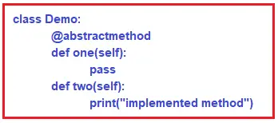
Abstract Class
Un-implemented methods:
A method which has only method name and no method body, that method is called an unimplemented method.
They are also called as non-concrete or abstract methods.
How to declare an abstract method in Python:
Abstract methods, in python, are declared by using @abstractmethod decorator.

Slide 108
Abstract Class
In above example
Method ‘one’ is abstract method. Method ‘two’ is non-abstract method. Since one abstract method is present in class ‘Demo’, it is called Abstract class

Slide 109
Thank You

